Slide 1
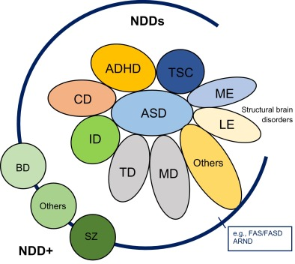
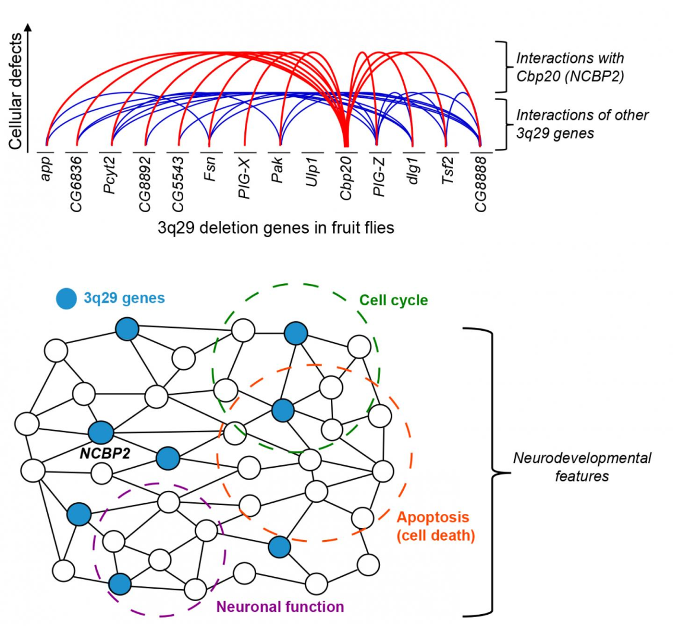
Deep learning model in analysing the Genetic variation associated with the occurrence and progression of Neurodevelopmental disorders

Slide 2
Team Members
COMPUTER SCIENCE | LIFE SCIENCE
Dr. S. Pitchumani Angayarkanni Associate Professor, Department of Computer Science Lady Doak College | Dr. S. Kalaivani Priyadarshini, Assistant Professor, Department of Biotechnology, Lady Doak College
Dr. Sofia, Associate Professor, Department of Computer Science, Lady Doak College. | Ms. Raga Priya UG Student Bioinformatics TN Agricultural university. Coimbatore

Slide 3
Interpretation of the statistical analysis result

Slide 4
Negative correlation of the finding with review of literature & Gene ontology study
 | Gene Name | NDD | Literature with supportive evidence
Pathogenic mutations | X-linked Neuroligin 4 gene (NLGN4X) | Autism | autism spectrum disorders (ASDs) and/or mental retardation (MR) are rare (Daoud , 2009).
Regulation of membrane potential | NLGN3,NLGN4X | Autism | positive regulation of excitatory postsynaptic potential and it is unclear according to the literature of how mutations in NLGN4X result in neurodevelopmental defects is associated with autism (Lingling, 2013)

Slide 5
Negative correlation of the finding with review of literature & Gene ontology study
 | Gene Name | NDD | Literature with supportive evidence
Regulation of membrane potential | SPCOK3 | ADHD | not associated with Negative regulation of cell motility because it is associated with Hemostatic Risk Factors and Arterial Thrombotic Disease(Reiner,2001)
Regulation of membrane potential | MFC2C | (AUTISM,DMD,ADHD | negative regulation of blood vessel endothelial cell migration (Schechter DS et. al., 2017).

Slide 6
Negative correlation of the finding with review of literature & Gene ontology study
 | Gene Name | NDD | Literature with supportive evidence
Cellular response to transforming growth factor beta stimulus | DUSP15 | ADHD | not associated with Negative regulation of cell motility because it is associated with Hemostatic Risk Factors and Arterial Thrombotic Disease(Reiner,2001)
Cellular response to transforming growth factor beta stimulus | HTR3A | (AUTISM | associated with regulation of membrane potential according to gene ontology annotation but it is associated with suicidal behaviour(Souza et. al., 2011).

Slide 7
Negative correlation of the finding with review of literature & Gene ontology study
 | Gene Name | NDD | Literature with supportive evidence
Cellular response to transforming growth factor beta stimulus | LTBP4 | DMD | is associated with transforming growth factor beta receptor signalling pathway and leads to kidney disease (https://maayanlab.cloud/Harmonizome/gene_set/Kidney+Diseases/CTD+Gene-Disease+Associations)

Slide 8
Mismatch in negative correlation findings
 | Gene Name | NDD | Literature with supportive evidence
Vocalization Behaviour | CNTNAP2 | AUTISM | gene as a risk factor for ASD and related neurodevelopmental disorders (Peñagarikano et. al.,2012).
Negative regulation of cell mobility | DAG1 | DMD | gene ontology study online tool mismatches with the findings
cellular response to transforming growth factor beta stimulus | MEF2C | AUTISM

